Slide 1
Road Accident Severity Prediction
Yixuan Lu

Slide 2
CONTENTS
01 Introduction & Project Objective
02 Data Description
03 Exploratory Data Analysis (EDA)
04 Modeling
05 Results
06 Conclusion & Recommendations

Slide 3

Three high school students die in Christmas Day car crash
Despite safer cars, traffic fatalities are on the rise
WHO:Road traffic injuries are predicted to become the seventh leading cause of death by 2030.
Woman, 28, killed in three-vehicle crash on Moray road
DFT in UK: There were 1,870 road deaths in Great Britain in the year ending June 2019 which is an increase compared to the previous year.

Slide 4

Introduction & Project objective
Use data visualization to better understand road accident severity condition
Eleven models were built, evaluated for complexity and accuracy, and compared to conclude which model is the best fit for predicting accident severity
The potential to predict the accident severity is useful not only to public safety stakeholders but also transportation administrators and individual travelers.

Slide 5

Data Description
Road accidents data between 2005 and 2016 in the United Kingdom
Number of categorical:38
Number of numerical:25
Target variable: Accident_Severity
63 2M+
columns rows

Slide 6
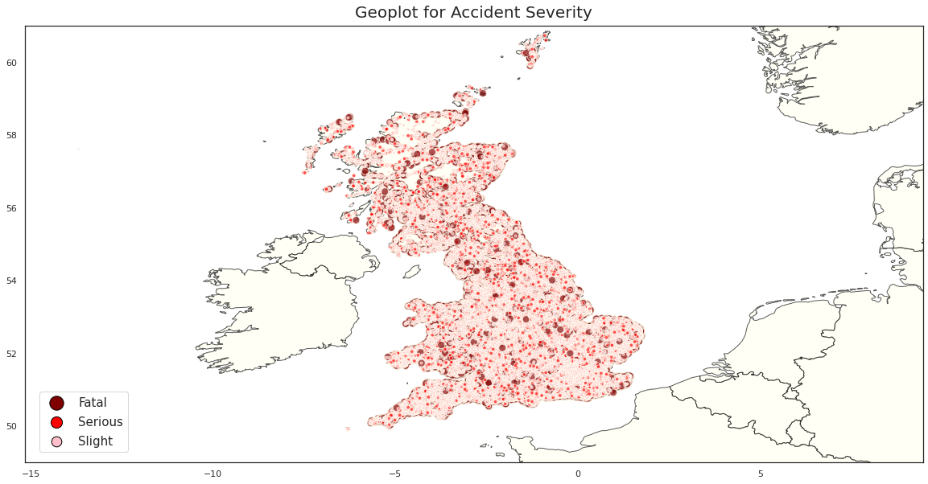
Exploratory Data Analysis (EDA)

Slide 7
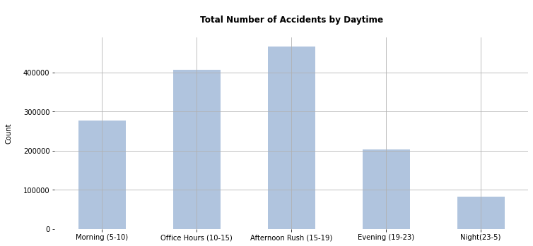
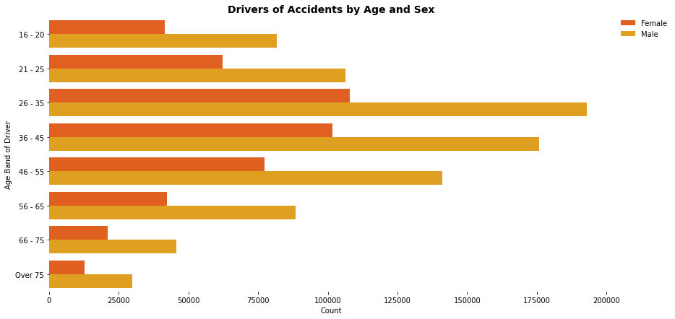
EDA (Cont.)
When is the most accidents happen?
What are the age and gender of the drivers who cause an accident?

Slide 8
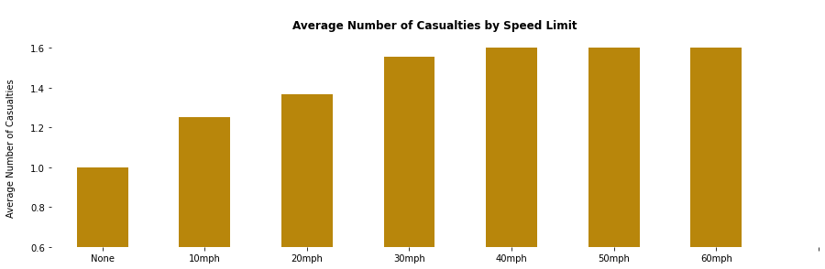
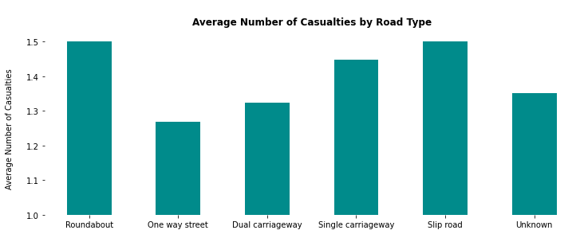
EDA (Cont.)
Number of casualties increased by Speed Limit
Road type- Roundabout & Slip road

Slide 9
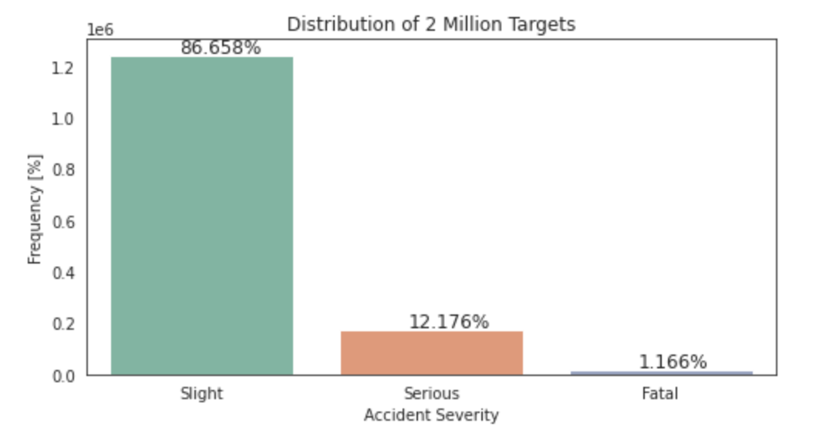
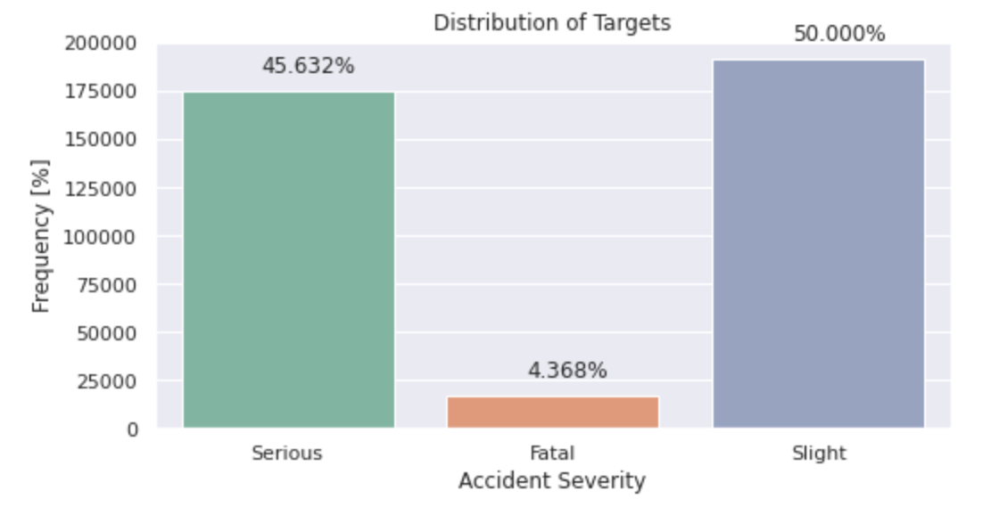
Modeling
Imbalanced Data
Slight = 0
Serious & Fatal = 1
86.658% ‘0’ and 13.342% ‘1’
Balanced Data
Slight = 0
Serious & Fatal = 1
50% ‘0’ and 50% ‘1’

Slide 10
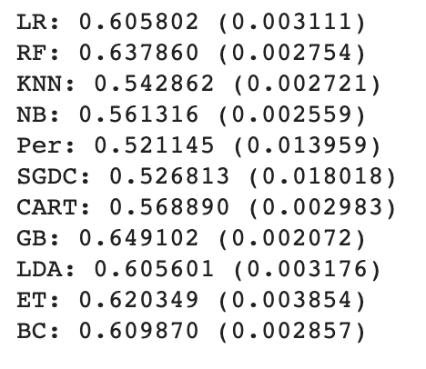
Modeling
Polynomials
Interaction terms
90% of columns are categorical
LogisticRegression
RandomForestClassifier
KNeighborsClassifier
GaussianNB
Perceptron
SGDClassifier
DecisionTreeClassifier
GradientBoostingClassifier
LinearDiscriminantAnalysis
ExtraTreesClassifier
BaggingClassifier
scoring = 'accuracy'

Slide 11
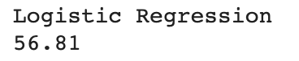
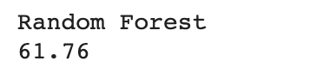
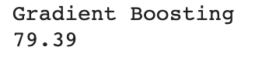
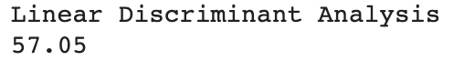
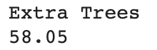
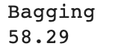
Modeling
LogisticRegression
RandomForestClassifier
KNeighborsClassifier
GaussianNB
Perceptron
SGDClassifier
DecisionTreeClassifier
GradientBoostingClassifier
LinearDiscriminantAnalysis
ExtraTreesClassifier
BaggingClassifier
Hyperparameter Tuning

Slide 12
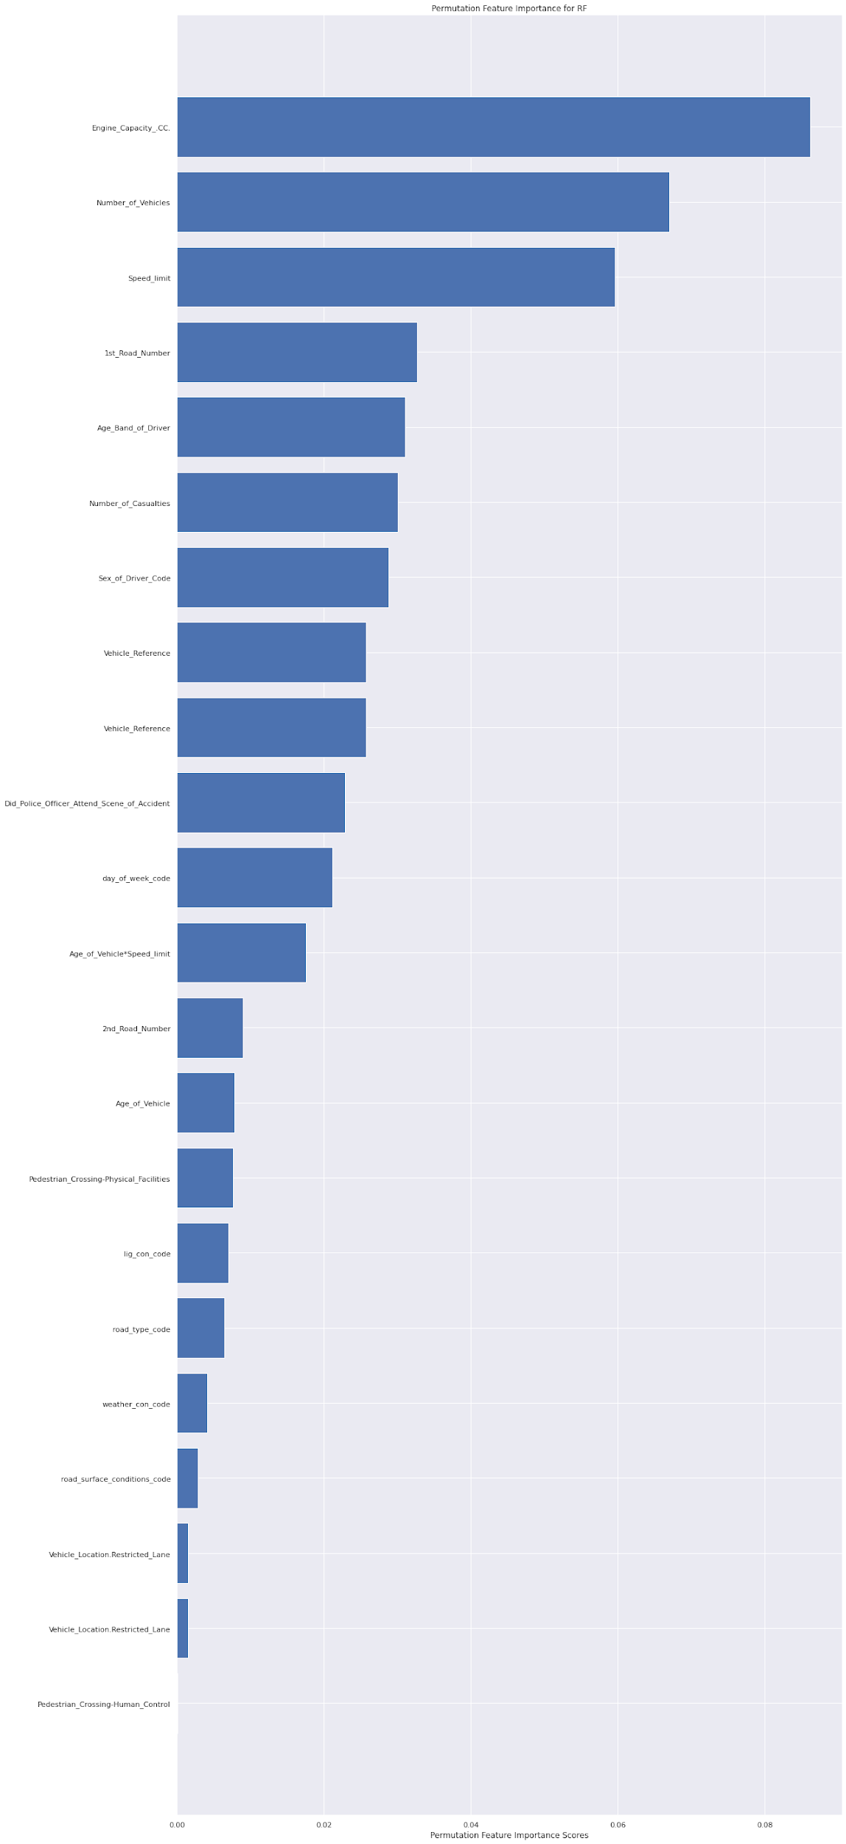
Modeling
Permutation Test
To improve models

Slide 13
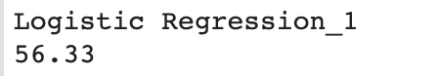
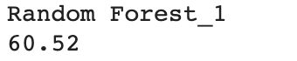
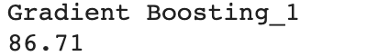
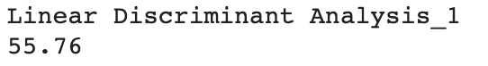
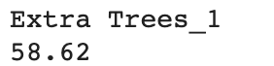
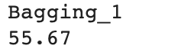
Modeling
LogisticRegression
RandomForestClassifier
KNeighborsClassifier
GaussianNB
Perceptron
SGDClassifier
DecisionTreeClassifier
GradientBoostingClassifier
LinearDiscriminantAnalysis
ExtraTreesClassifier
BaggingClassifier
Hyperparameter Tuning
(after Permutation Test)

Slide 14
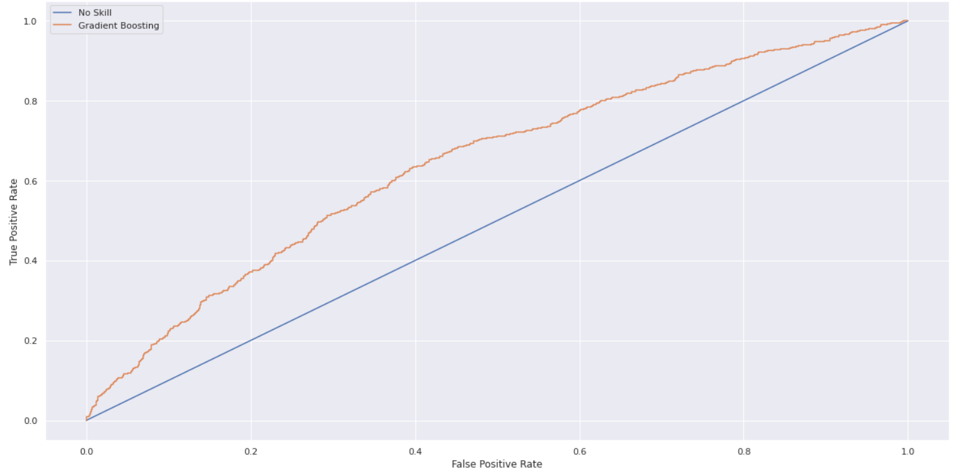
Results
AUC ROC
0.644
ROC for Gradient Boosting Model

Slide 15
Results
How can we improve our model performance?
Data Sampling
Stronger Predictors
Models Selection
Other Improvements
Notes:
Other improvements: AIC, BIC, Chi-square...

Slide 16
Conclusion & Recommendations
We investigated the problem of traffic accident severity prediction using Road traffic accident analysis data. This was a challenging problem due to class imbalanced as majority of the accident severity belonged to Slight accident severity. It was surprising to see that weather and light condition did not had much impact on the fatal and severe accident severity. We saw that during the permutation testing, features like engine capacity, number of vehicles, speed limit, age group of drivers played an important role for improving the accuracy of the Gradient boosting classifier model.
For the future work, we want to see the results while working with the whole dataset and not have computing restrictions. Since the scope of the course was about leaning the data science concept using machine learning algorithms, we hope to see what we can achieve using deep learning models for such heavy dataset which has many categorical predictor variables.
Looking at the results, we believe that we should have done negative sampling and tried building the models. We also learned that with more features such as real time traffic information, construction, important events, higher resolution weather could have helped the model to improved significantly. We also want to see how our model performs by assigning weights to each class of our target variable.

Slide 17
THANK YOU

